Slide 1
Arbitrary Albatross: Neutral Names for Vulnerabilities
Art Manion
Leigh Metcalf, PhD
Flocon 2019

Slide 2
Copyright 2018 Carnegie Mellon University. All Rights Reserved.
This material is based upon work funded and supported by the Department of Defense under Contract No. FA8702-15-D-0002 with Carnegie Mellon University for the operation of the Software Engineering Institute, a federally funded research and development center.
The view, opinions, and/or findings contained in this material are those of the author(s) and should not be construed as an official Government position, policy, or decision, unless designated by other documentation.
NO WARRANTY. THIS CARNEGIE MELLON UNIVERSITY AND SOFTWARE ENGINEERING INSTITUTE MATERIAL IS FURNISHED ON AN "AS-IS" BASIS. CARNEGIE MELLON UNIVERSITY MAKES NO WARRANTIES OF ANY KIND, EITHER EXPRESSED OR IMPLIED, AS TO ANY MATTER INCLUDING, BUT NOT LIMITED TO, WARRANTY OF FITNESS FOR PURPOSE OR MERCHANTABILITY, EXCLUSIVITY, OR RESULTS OBTAINED FROM USE OF THE MATERIAL. CARNEGIE MELLON UNIVERSITY DOES NOT MAKE ANY WARRANTY OF ANY KIND WITH RESPECT TO FREEDOM FROM PATENT, TRADEMARK, OR COPYRIGHT INFRINGEMENT.
[DISTRIBUTION STATEMENT A] This material has been approved for public release and unlimited distribution. Please see Copyright notice for non-US Government use and distribution.
This material may be reproduced in its entirety, without modification, and freely distributed in written or electronic form without requesting formal permission. Permission is required for any other use. Requests for permission should be directed to the Software Engineering Institute at permission@sei.cmu.edu.
DM18-1007

Slide 3

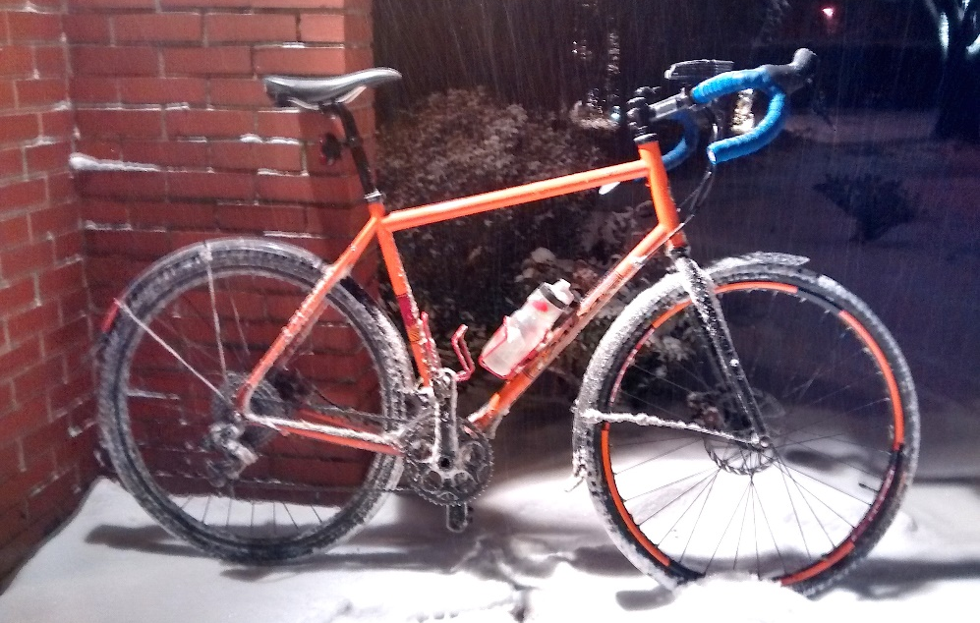
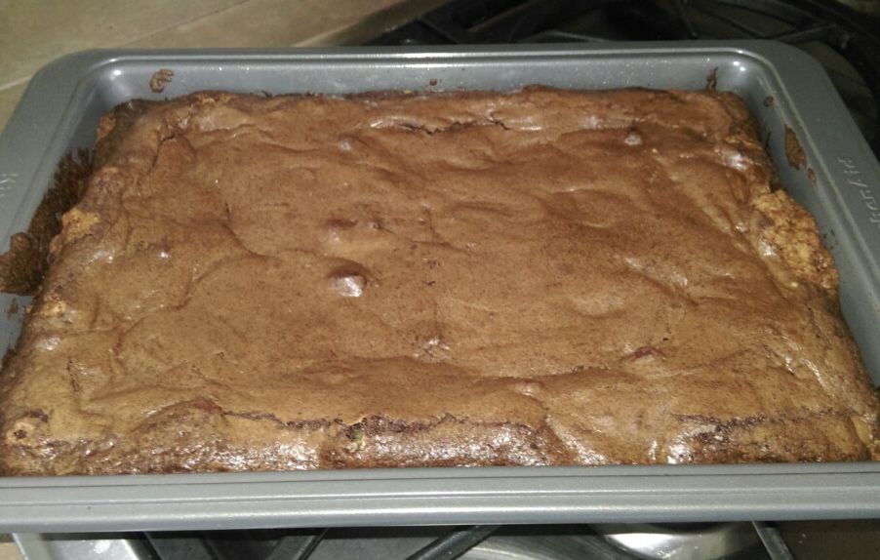
Art
Technical Manager “slash” Principal Engineer
Coordinated Vulnerability Disclosure
@zmanion
Leigh
Math: Ph. D. in Algebraic Topology
DNS blacklist analysis
co-Editor-in-Chief, ACM Digital Threats Research and Practice

Slide 4
Vulnerability Identification
Foundational vulnerability information system requirement
Coordinated Vulnerability Disclosure
(Known) vulnerability scanning and management
Identification already exists – lots of it
Example: CUPS vulnerabilities published 2015-06-08
CVE: CVE-2015-1158, CVE-2015-1159
CERT/CC: VU#810572
CUPS: STR #4609
FreeBSD: r389006
For much, much more detail, see: Buying Into the Bias: Why Vulnerability Statistics Suck (Martin and Christey)

Slide 5

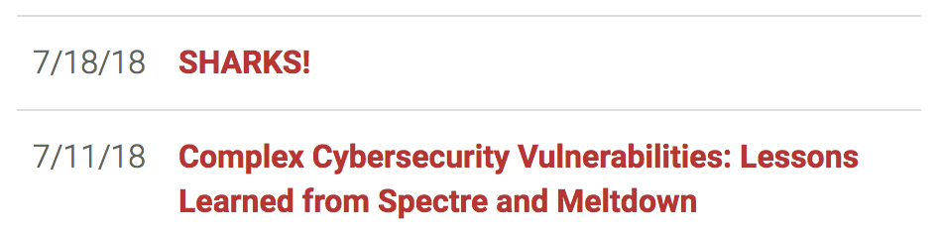
Numbers and Words
Professionals (and nerds) are OK with numbers
The other 7.5999 billion humans on the planet are not, and they shouldn’t need to be
But, sometimes, they need to talk about vulnerabilities

Slide 6
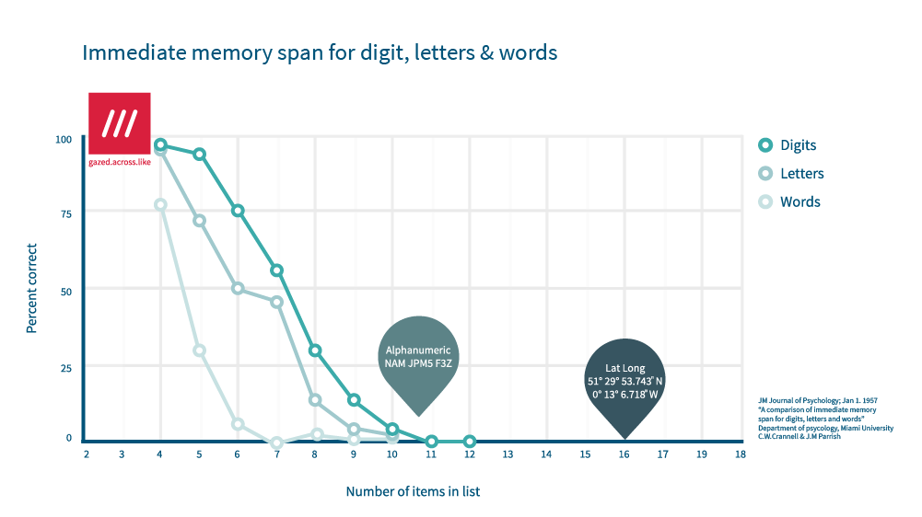
Numbers and Words
https://what3words.com/wp-content/uploads/2017/01/unspecified.png

Slide 7
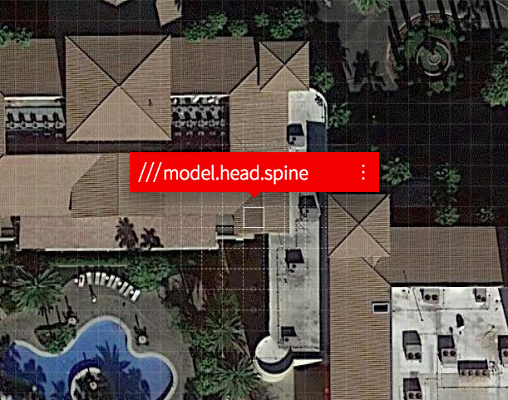
Names for Other Things
Storms
Easier to measure than vulnerabilities
Physical properties
Scale
Authority
NOAA
The Weather Channel
Map the surface of earth
WHAT3WORDS
///model.head.spine

Slide 8
Numbers and Words
Feature | Numbers | Words
Uniqueness | Yes | Yes, in sufficient combinations
Recognition | No | Yes
Meaning | No | Yes
Computing | Yes | No

Slide 9



Names and Branding
Some vulnerabilities are named, usually by researchers
Some are also marketed
Marketing is often more than a name
Logo, website, press release, language

Slide 10
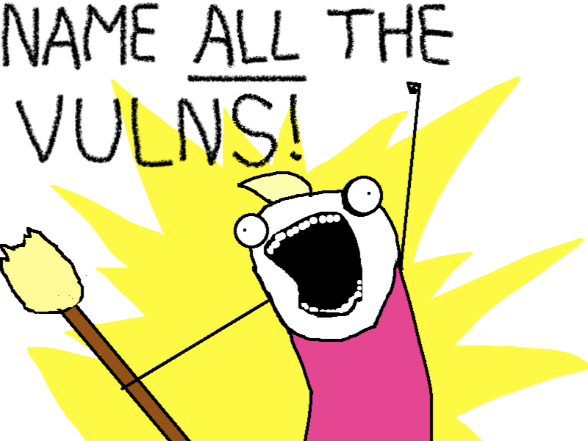
Naming Vulnerabilities
All? Some? By what dimension?
“Severity”
I hope you weren’t expecting us to recommend CVSS
Threat, likelihood of exploitability
Attention
Number of references in NVD
Neutrally
Recognizable words, names, but no special meaning
Or not neutrally?
Associate meaning, or at least connotation with some dimension of the vulnerability
Severity, threat, attention, similarity
Derived from “This is Why I'll Never be an Adult” by Allie Brosh under CC BY-NC-ND 3.0 US
Notes:
how much being talked about
# of NVD reference URLs
threat (PoC, in metasploit)

Slide 11

Words and Names
Language
English, more ASCII imperialism
De-facto global technical language
Could chose another language
Grammar
${adjective} ${noun}?
Order EN: red dog FR: chien rouge
${noun} ${noun}…
Scale
How many names do we need?
Partition? By year, like CVE IDs?
Deterministic
Catalog number (CVE ID) → Name

Slide 12
Meaning and Connotation
Numbers (and other characters) are symbols
Words have meaning, connotation
Fluency – common expression
Salience – evocative, taboo/non-taboo
Rhyme, alliteration
Pop-out – creative swearing
Paired learning – similar words or opposites
Emotional dictionary

Slide 13
Words and Names
Family names
Similarity, as in Shellshock or Spectre variants
Multiple CVE IDs for a groups
Requires prior knowledge of the similarity
Which may require human effort, possibly some NLP magic like locality-sensitive hashing
Conversely, unless similarity or relationship is intentional, repeated words do not imply relationship

Slide 14

Math and (more) Science
What does a solution look like?
Words
Enough words and combinations
Method to turn catalog numbers into words
“Leigh co-authored this book, so I’ll ask her to work on it.”

Slide 15
Word List One
I started by scraping the Wiktionary: https://www.wiktionary.org/
I got a lot of words doing this
518,758 adjectives
1,047,224 nouns
I can name a LOT of vulnerabilities, 543,255,827,792 to be precise
Problem? These are ALL THE WORDS and, well...

Slide 16
Word List One
Adjectives | Nouns
duodenal urethral executory impiteous anatomical | maguey flatus circumjacence steeplechaser mutinousness

Slide 17
Word List Two
Corpus tagged for parts of speech: https://www.anc.org/oanc/
Create two lists from all singular adjectives and nouns
7,468 adjectives and 30,409 nouns, or 227,094,412 possible names
In testing, I ran across some interesting combinations
I refuse to name a vulnerability “gelatinous whitehead”
And that was a replacement
Filter out all terms found in the Urban Dictionary?
So maybe we need to go to word list three
Notes:
Triggering words

Slide 18
Word List Three
I found lists of common adjectives and nouns by searching Google.
This gave me 1,347 adjectives and 4,553 nouns
Which will cover 6,132,891 named vulnerabilities
On the plus side, nothing too offensive!
Names such as “apologetic alligator” and “corrupt birdbath” and “tickled allegro”

Slide 19
Word List Four
I found a paper that studies the emotional context of words, giving a numerical rating to each
http://crr.ugent.be/papers/Warriner_et_al_affective_ratings.pdf
Luckily, they offer a word list
http://crr.ugent.be/archives/1003
Using this, I made a list of 1,470 adjectives and 5,813 nouns using a scientific method of ‘these look happy’ (ie, everything above this value is a happy word).
Want the vulnerability “yummy nudity?” It can be yours!

Slide 20
Constraints
Each number must map to two words and the words must be unique to the number
The function must be surjective and injective
It must be repeatable
This mean randomness is out
I don’t want to tie it to a specific set of words

Slide 21
Method One
Method One
I have numbers, we’ll call them x. I have n adjectives and m nouns
First thought… modulus!
The adjective will be x%n and the noun will be x%m
Well, that doesn’t work. Collisions galore!
Let n = 5, m = 7. If x = 100, so 100%5 = 0 and 100%7 = 2
On the other hand, if y = 240, then 240%5 = 0 and 240%7 = 2

Slide 22
Method Two
Method Two
This one is based in Number Theory
We have n adjectives and m nouns and a number x
We want to find integers a and b such that an + bm = x
This has a solution…
…but, it isn’t unique unless n and m are relatively prime and x <= nm
Relatively prime means they share no common divisors (other than 1)
Example: 4 and 9
If we fiddled with our word lists, we might get relatively prime n and m… that’s really hard

Slide 23
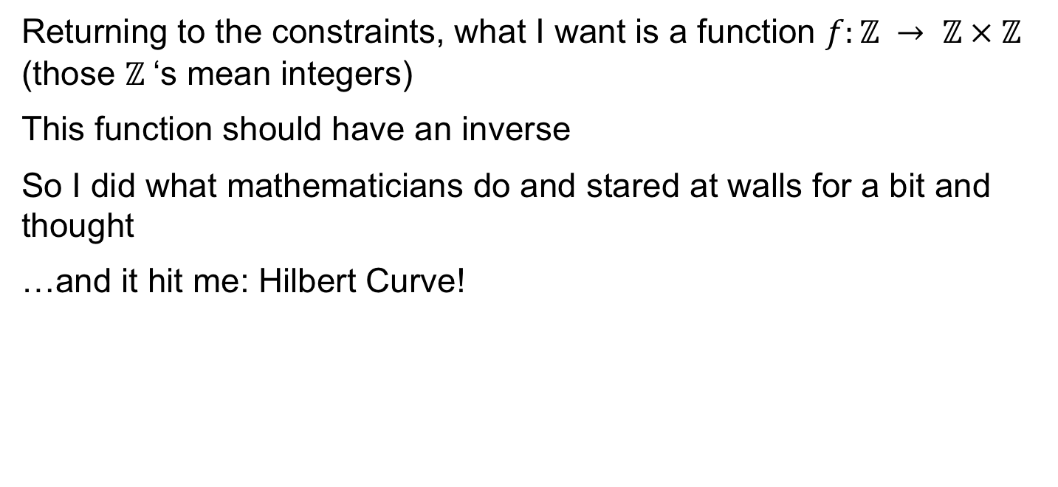
Method Three
Returning to the constraints, what I want is a function $f:ℤ → ℤ × ℤ$ (those $ℤ$‘s mean integers)
This function should have an inverse
So I did what mathematicians do and stared at walls for a bit and thought
…and it hit me: Hilbert Curve!

Slide 24
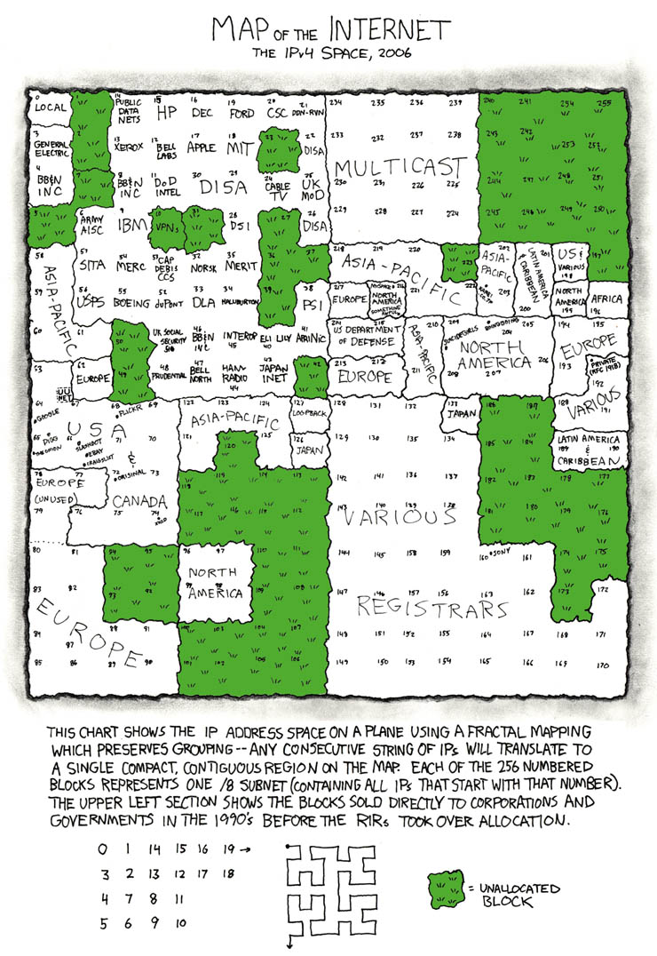
Hilbert Curve

Slide 25
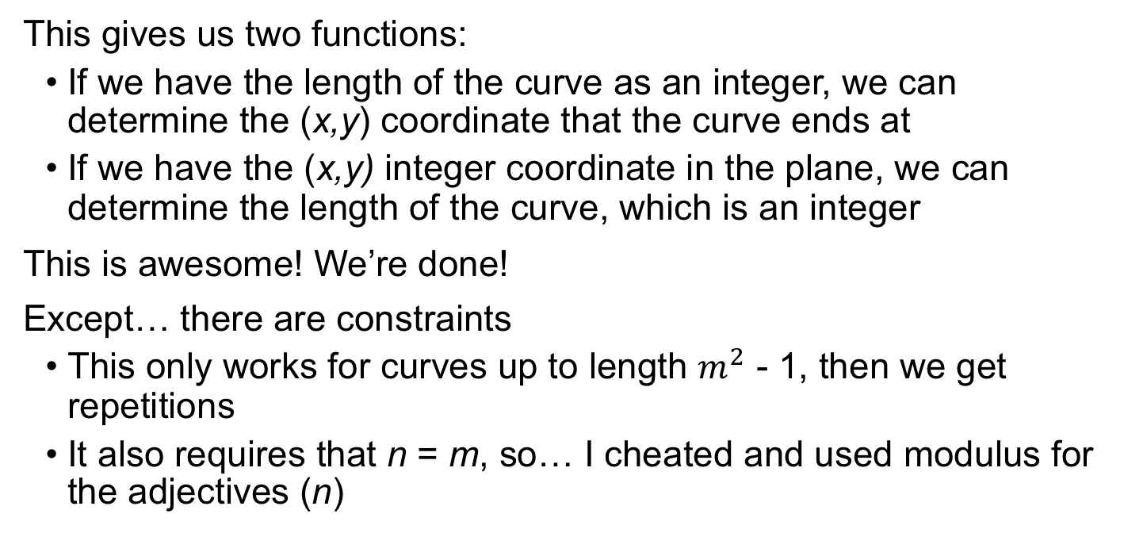
Hilbert Curve
This gives us two functions:
If we have the length of the curve as an integer, we can determine the (x,y) coordinate that the curve ends at
If we have the (x,y) integer coordinate in the plane, we can determine the length of the curve, which is an integer
This is awesome! We’re done!
Except… there are constraints
This only works for curves up to length $m^{2}$ - 1, then we get repetitions
It also requires that n = m, so… I cheated and used modulus for the adjectives (n)

Slide 26
Numbers to Names
I have:
✅ Words
✅ ️Methods
❓ Input
CVE IDs: CVE-YYYY-N…
How big is this number again?
If we remove ‘–’ and consider YYYYN… as the number we’re mapping to a word pair, then CVEs tend to be larger than number of adjectives (n) times the number of nouns (m), especially for the smaller word lists
Notes:
︎ ☑️

Slide 27
Numbers to Names
Options
Take the modulus of the CVE by the total number of word combinations
Oops, collisions!
Take CVE – Minimum CVE and try that
Which doesn’t reduce IDs like CVE-2015-1000002 enough
Use MATH and solve this better
Hint: Cantor Pairing/Unpairing functions
The problem is that this gives some names with two words and some with three to four words
…still working on a solution

Slide 28
Examples

Slide 29

Spectre
V2
CVE-2017-5715
CPUs using speculative execution and branch prediction provide side-channel to read protected memory
common: deputy consideration
happy-words: genetic paradise
nlp: starched amplify
wikitionary: abdominovesical aerophysics

Slide 30
Spectre
V2 plus Severity
CVE-2017-5715
CPUs using speculative execution and branch prediction provide side-channel to read protected memory
Add “severity” as a dimension
CVSS v2 Base: 4.7 (sigh)
happy-words: abundant genetic paradise
nlp: accustomed starched amplify
CVSS 4.7 always maps to “abundant” or “accustomed”
Notes:
Intentionally not neutral, but providing meaning (in chosen and scored language word list at least)

Slide 31

Heartbleed
CVE-2014-0160
OpenSSL Heartbeat Extension packet over-read leaks process memory including private TLS keys
common: drawbridge clam
happy-words: economic freedom
nlp: submembranous alp
wikitionary: acclimatizable adolescency

Slide 32

Dirty COW
CVE-2016-5195
Linux kernel race condition in copy-on-write allows local privilege escalation
common: division craw
happy-words: heady convenience
nlp: stubble aneurysmal
wikitionary: acanthocarpous aftercomer

Slide 33

Unbranded 2001 IIS RCE
CVE-2001-0241
Buffer overflow in Windows 2000 IIS .printer ISAPI extension allows remote code execution as SYSTEM
common: flax bugle
happy-words: manageable fidelity
nlp: tonometric aggregate
wikitionary: adventuresome acroaesthesia

Slide 34
Notes:
End

